Slide 1
Thought for the week
8th July 2024
Do you have determination?
Determination is having a goal in mind and doing everything you can to achieve this goal.
Determination means never giving up on your dreams and goals.
Spiritual, Moral, Social and Cultural learning

Slide 2
Thought for the week
8th July 2024
not giving up
You can show determination by:
trying your best
setting some achievable goals for yourself
following school rules
asking for help if you need it.
Spiritual, Moral, Social and Cultural learning

Slide 3
Thought for the week
8th July 2024
At Weatherfield, we are all trying to be the best person we can be! This means not giving up and making sure we keep trying.
Spiritual, Moral, Social and Cultural learning

Slide 4
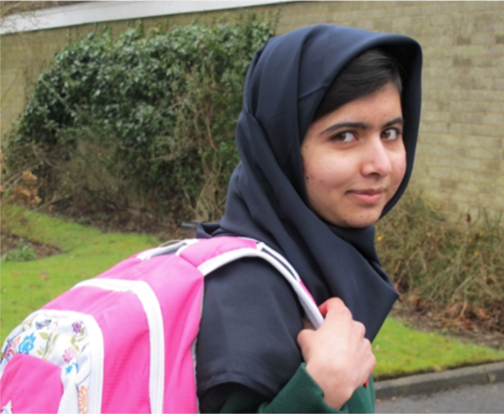
Thought for the week
8th July 2024
This is Malala and it is Malala Day on her birthday, Friday 12th July.
When she was just 11 years old, Malala made a speech about girls’ rights to education. This speech was listened to all over Pakistan.
Some bad people called the Taliban didn’t want girls going to school. They were angry at her for speaking up and being determined to get an education.
Spiritual, Moral, Social and Cultural learning

Slide 5
Thought for the week
8th July 2024
A few days later on her way home from school, two Taliban soldiers stopped the school bus.
“Who is Malala?” they shouted.
When her friends looked at her, the Taliban fired their guns. She was shot in the side of her head, but thankfully she did not die.
Spiritual, Moral, Social and Cultural learning

Slide 6
Thought for the week
8th July 2024
Malala moved to England, but carried on speaking out about better lives for girls. She set up a charity to help girls across the world to be able to go to school.
She didn’t let the bad people stop her determination to make a difference!
https://www.youtube.com/watch?v=7PL911uyKYs
Spiritual, Moral, Social and Cultural learning

Slide 7
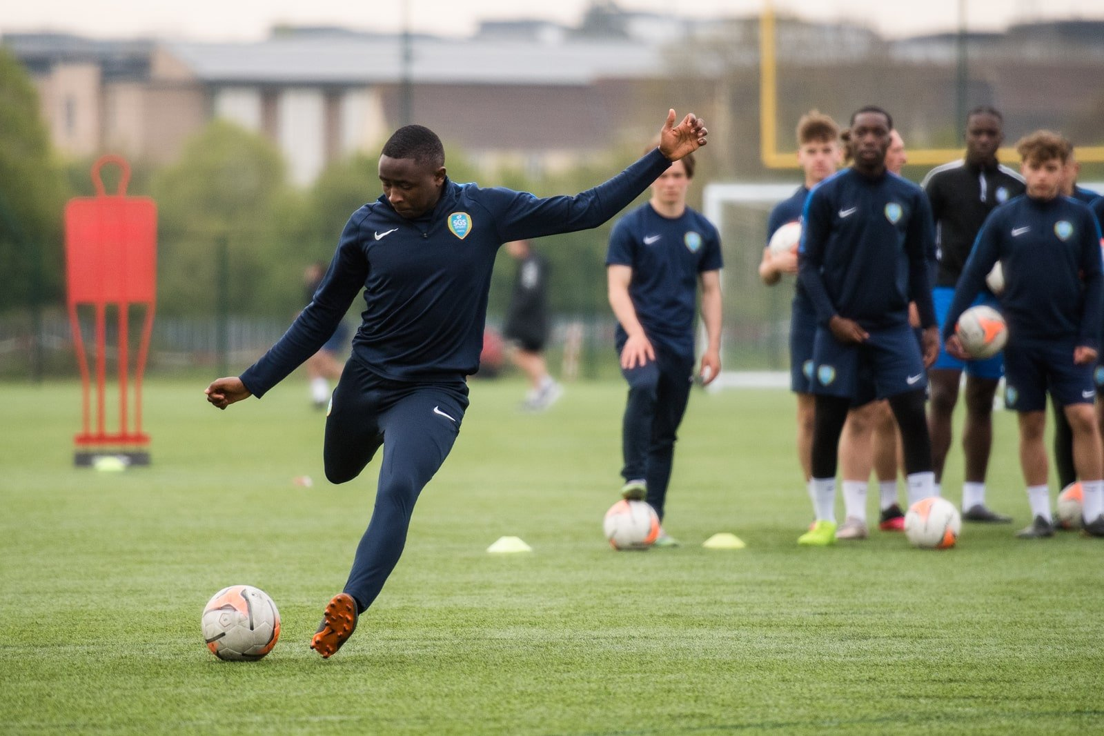
Thought for the week
8th July 2024
How can you show the value of determination?
Working hard to complete your coursework and assignments to gain entry into college.
Persevering in subjects you find hard.
Attending football coaching sessions to join a team
Practising your instrument or doing your chosen hobby every day.
Spiritual, Moral, Social and Cultural learning

Slide 8
Thought for the week
8th July 2024
Spiritual, Moral, Social and Cultural learning

