Slide 1
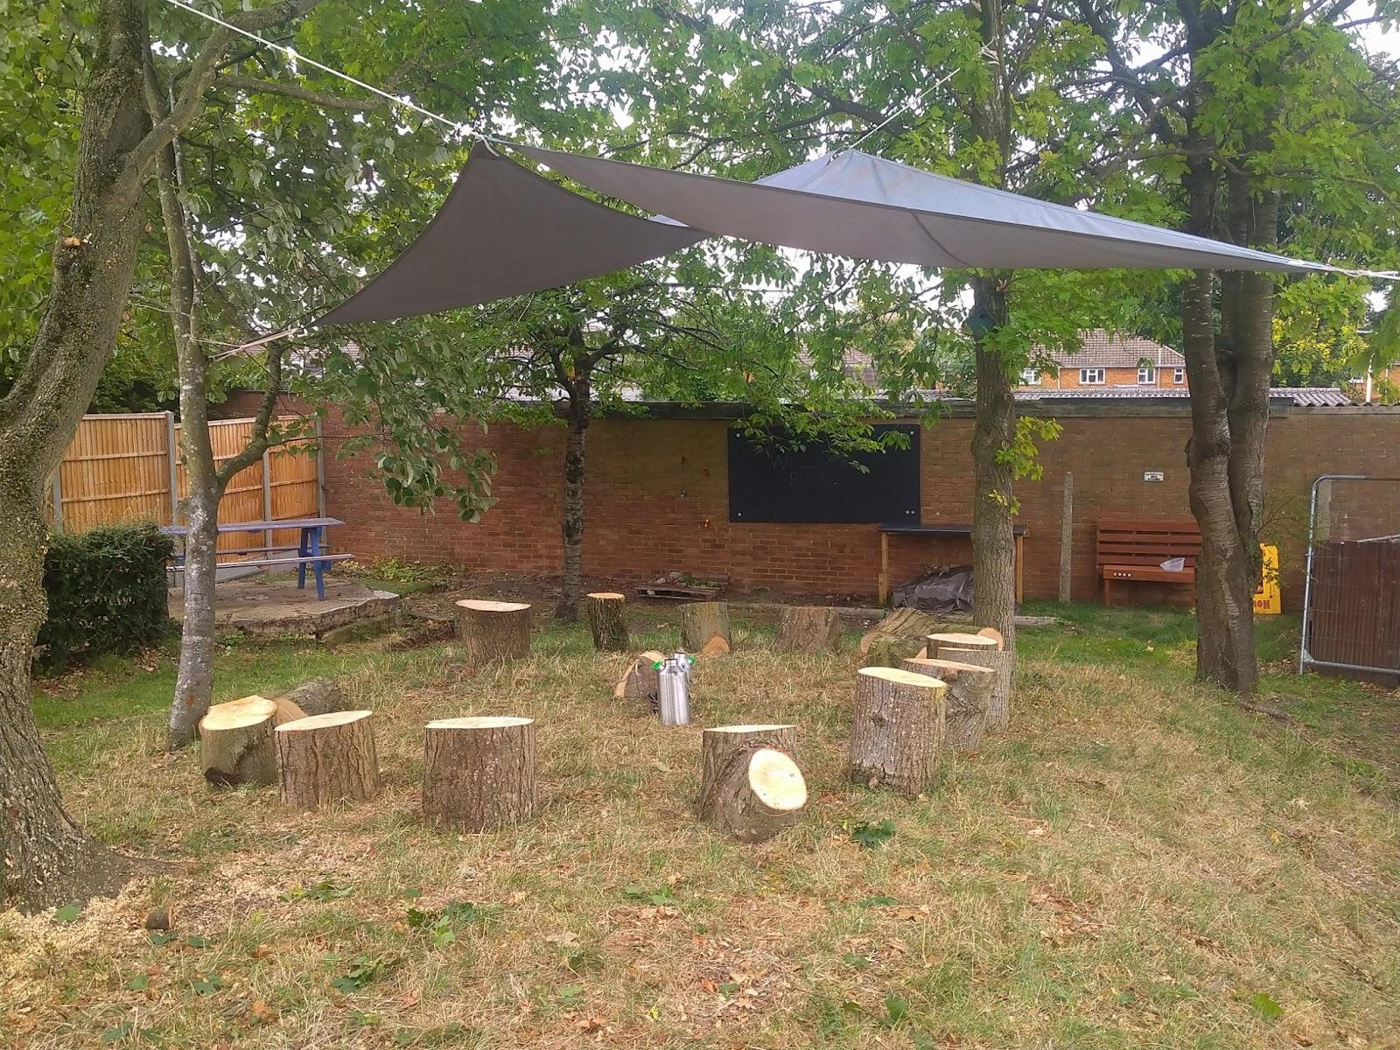
Welcome to Forest School at Weatherfield Academy
Mr Young Forest School Leader
Mr Harding Assistant Forest School Leader
Mrs Davis Forest School support

Slide 2
What our learners say about
Forest School
“Forest School is
wonderful.”
RC KS2
“Forest school is
relaxing. I love
learning new skills
out of the classroom.”
MM KS3
“I loved cooking flat bread over the open fire which we cut wood to create.”
KGK S3

Slide 3
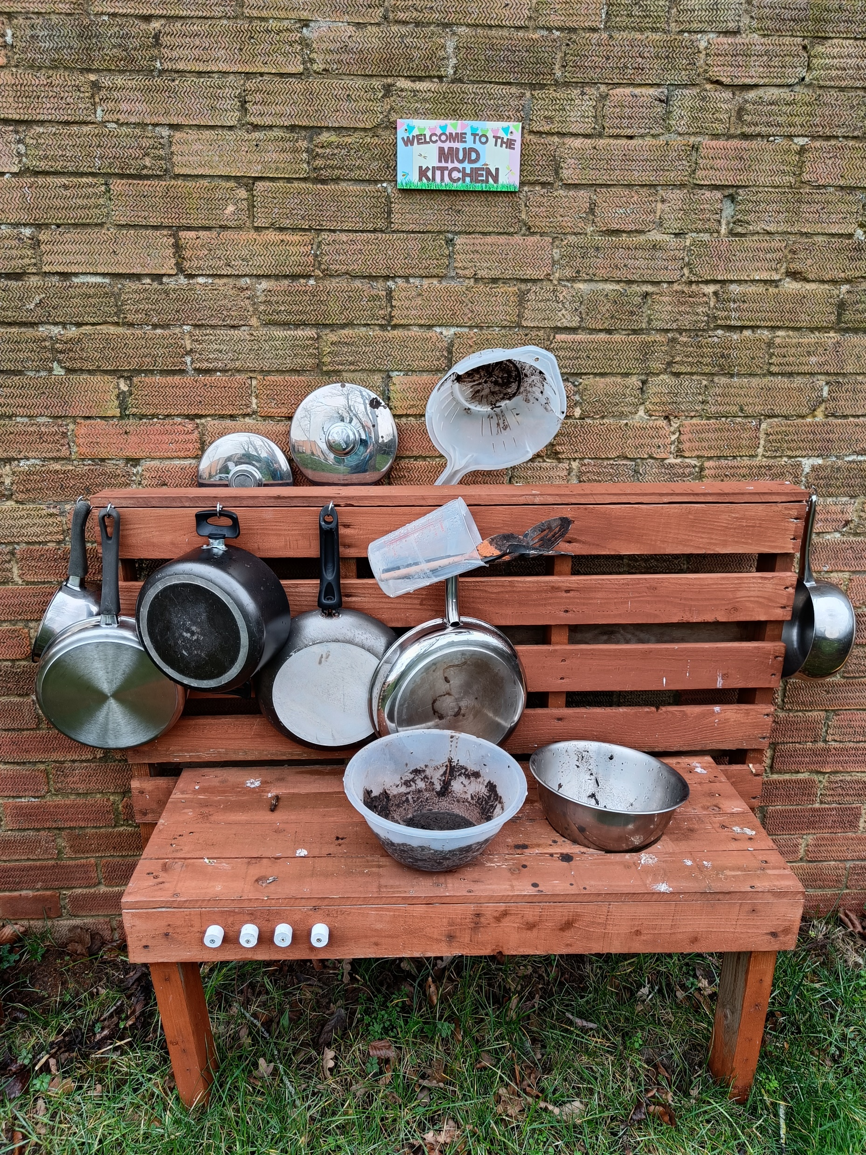
What is Forest School?
A learner-centred inspirational learning process of…….
Discovery
Exploration
Play
Imagination
Risk taking

Slide 4
How do we run a session?
We go out in all weathers – always wearing suitable clothing & footwear
We always start with stick tapping - link with lessons
We run a main activity - cutting wood, making, fire lighting, cooking, walking through Greenlanes etc
We have other activities - mud kitchen, shelter building etc
We evaluate the session – report back/discuss the learning
We say ‘thank you’ to the woods.

Slide 5
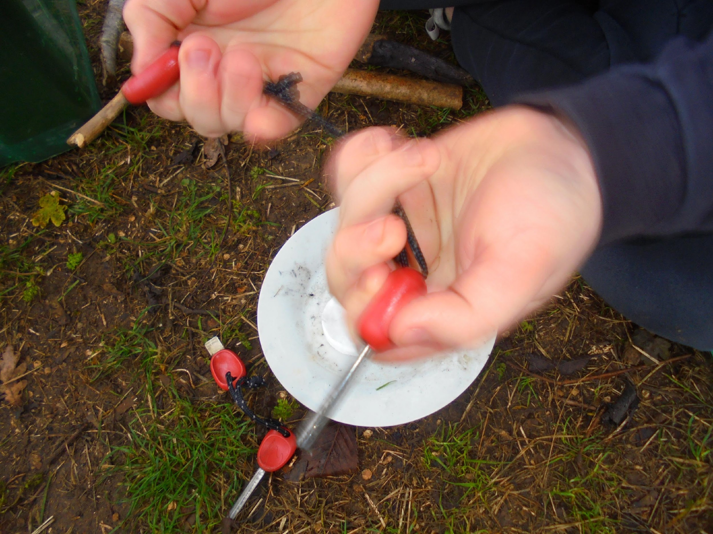
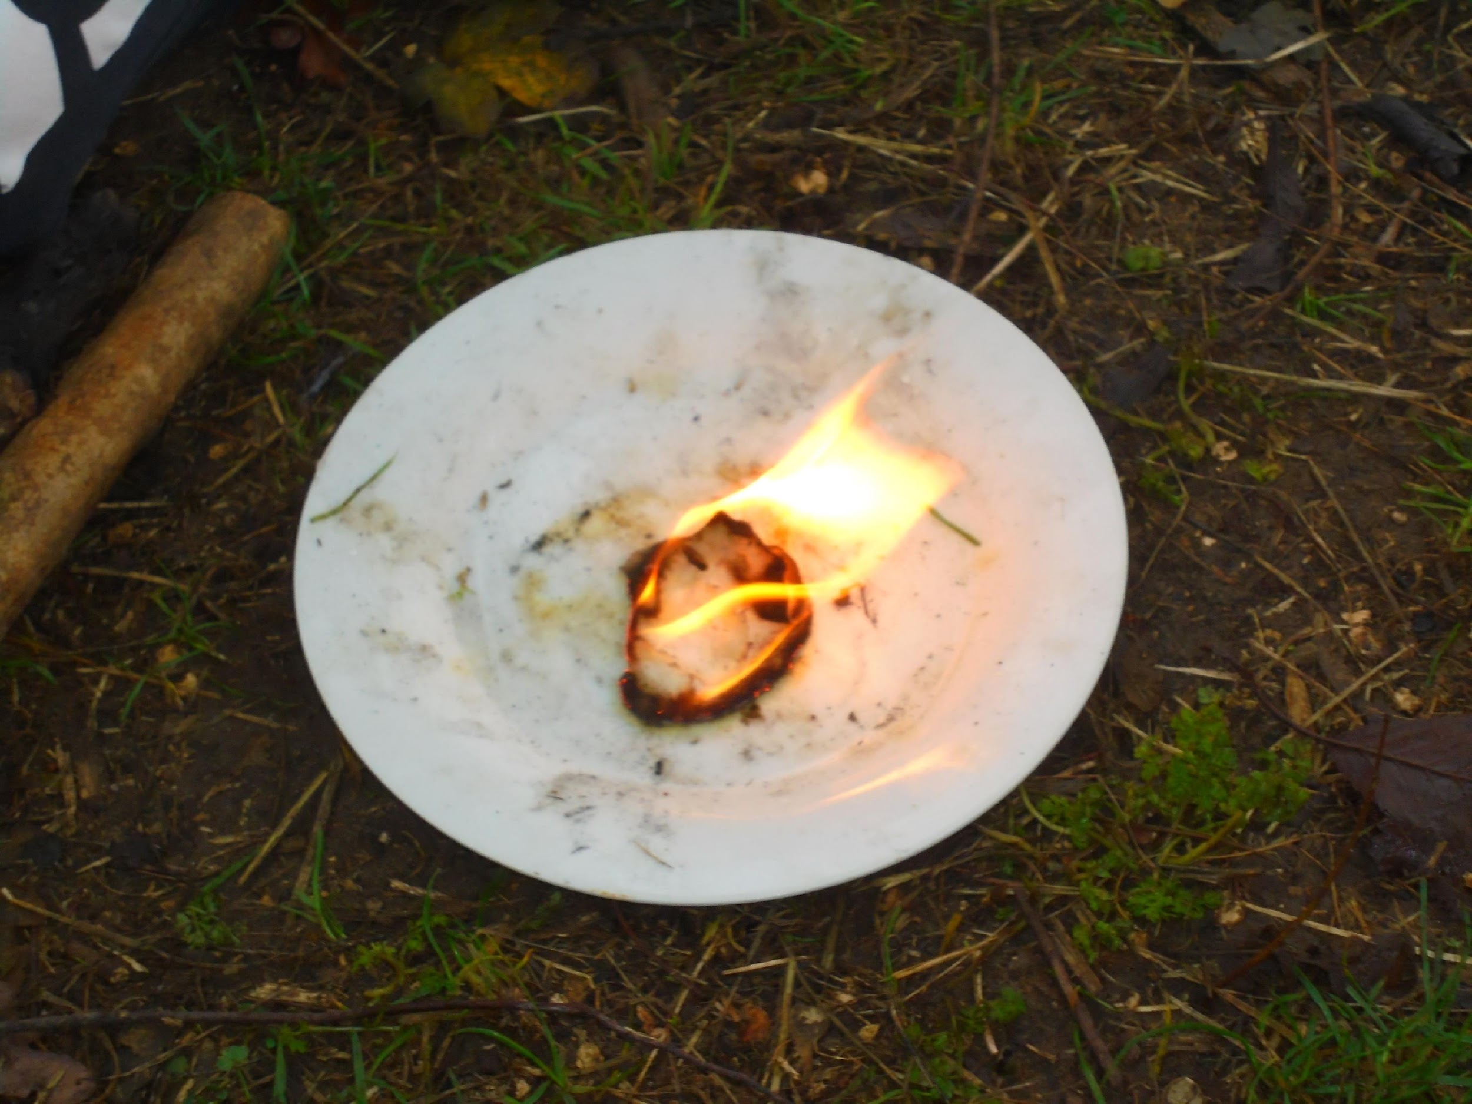

Slide 6
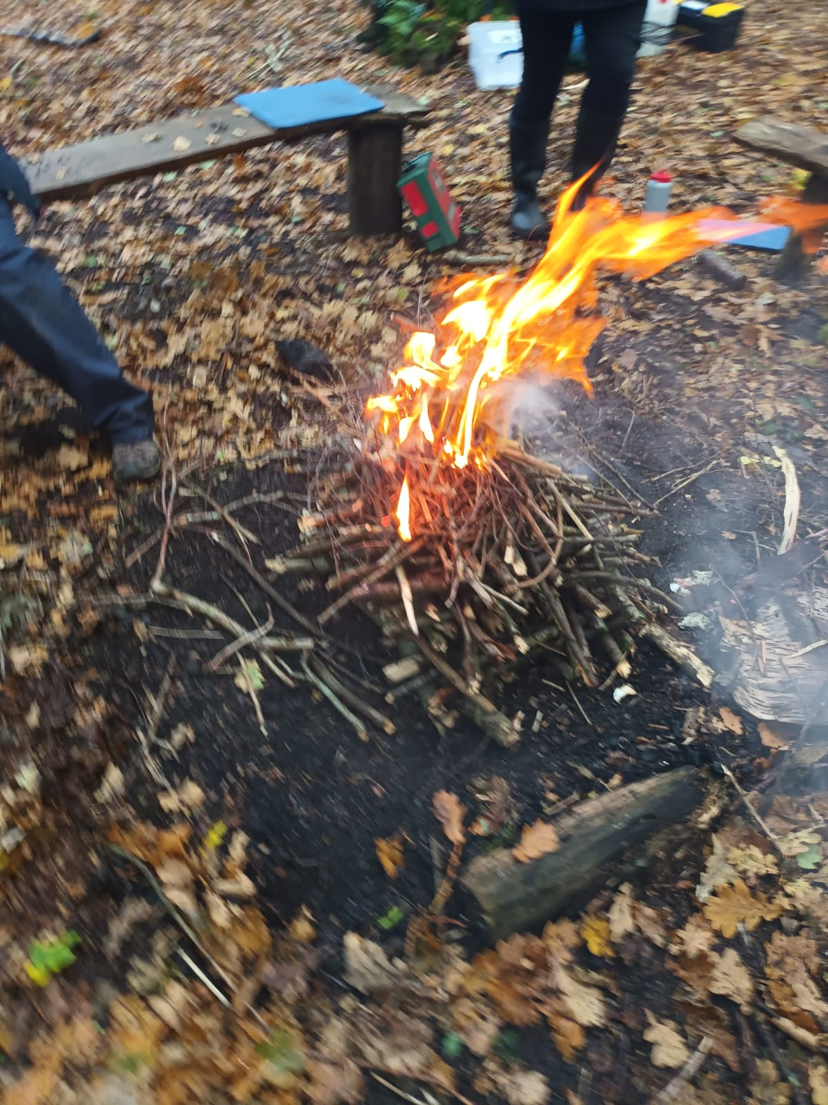
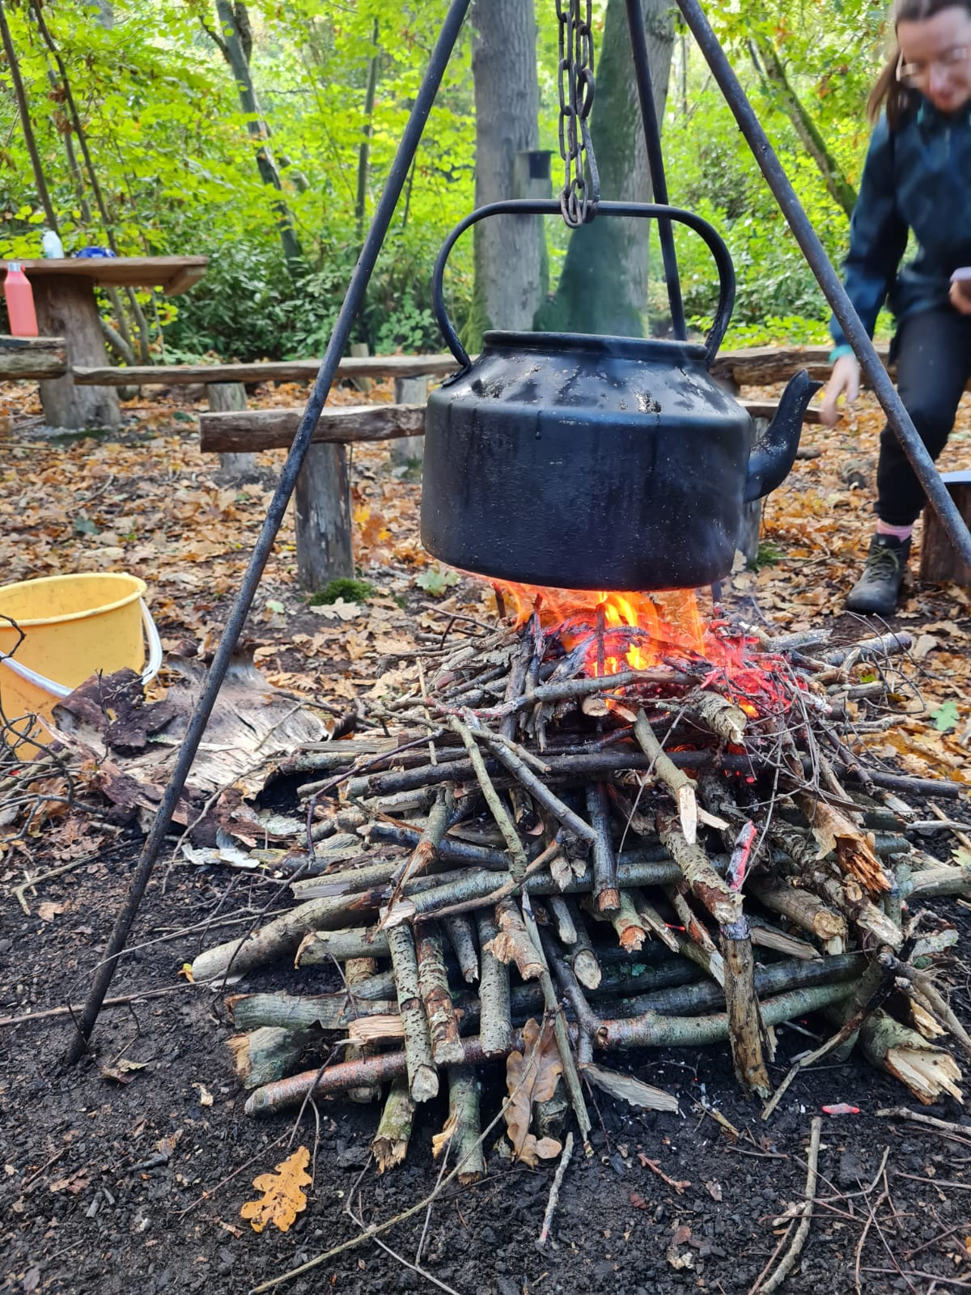

Slide 8
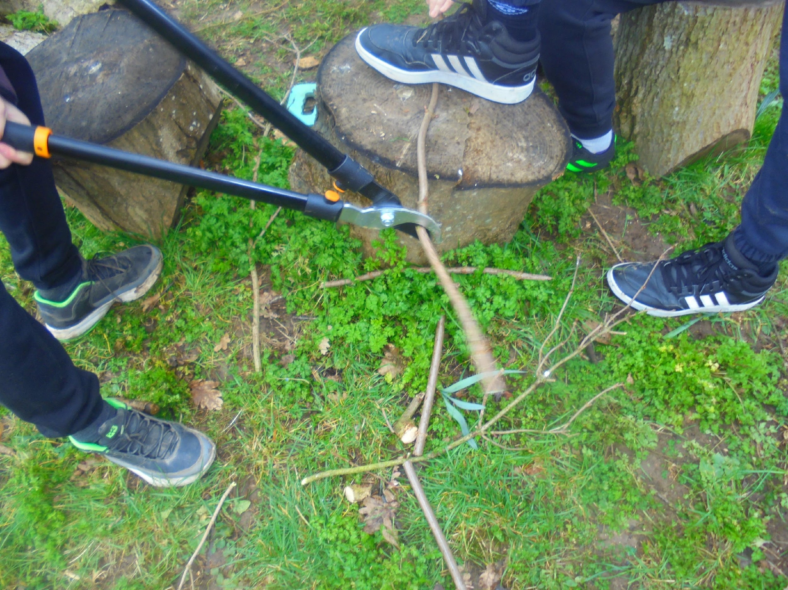

Slide 9
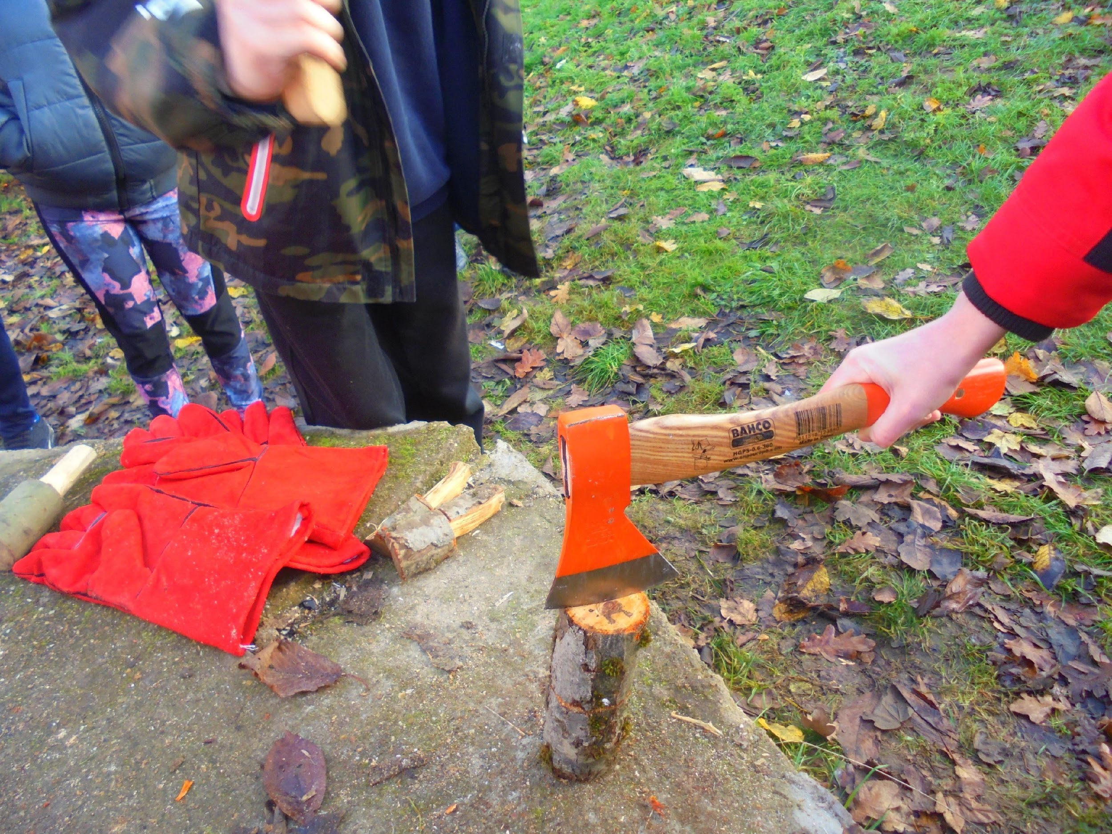
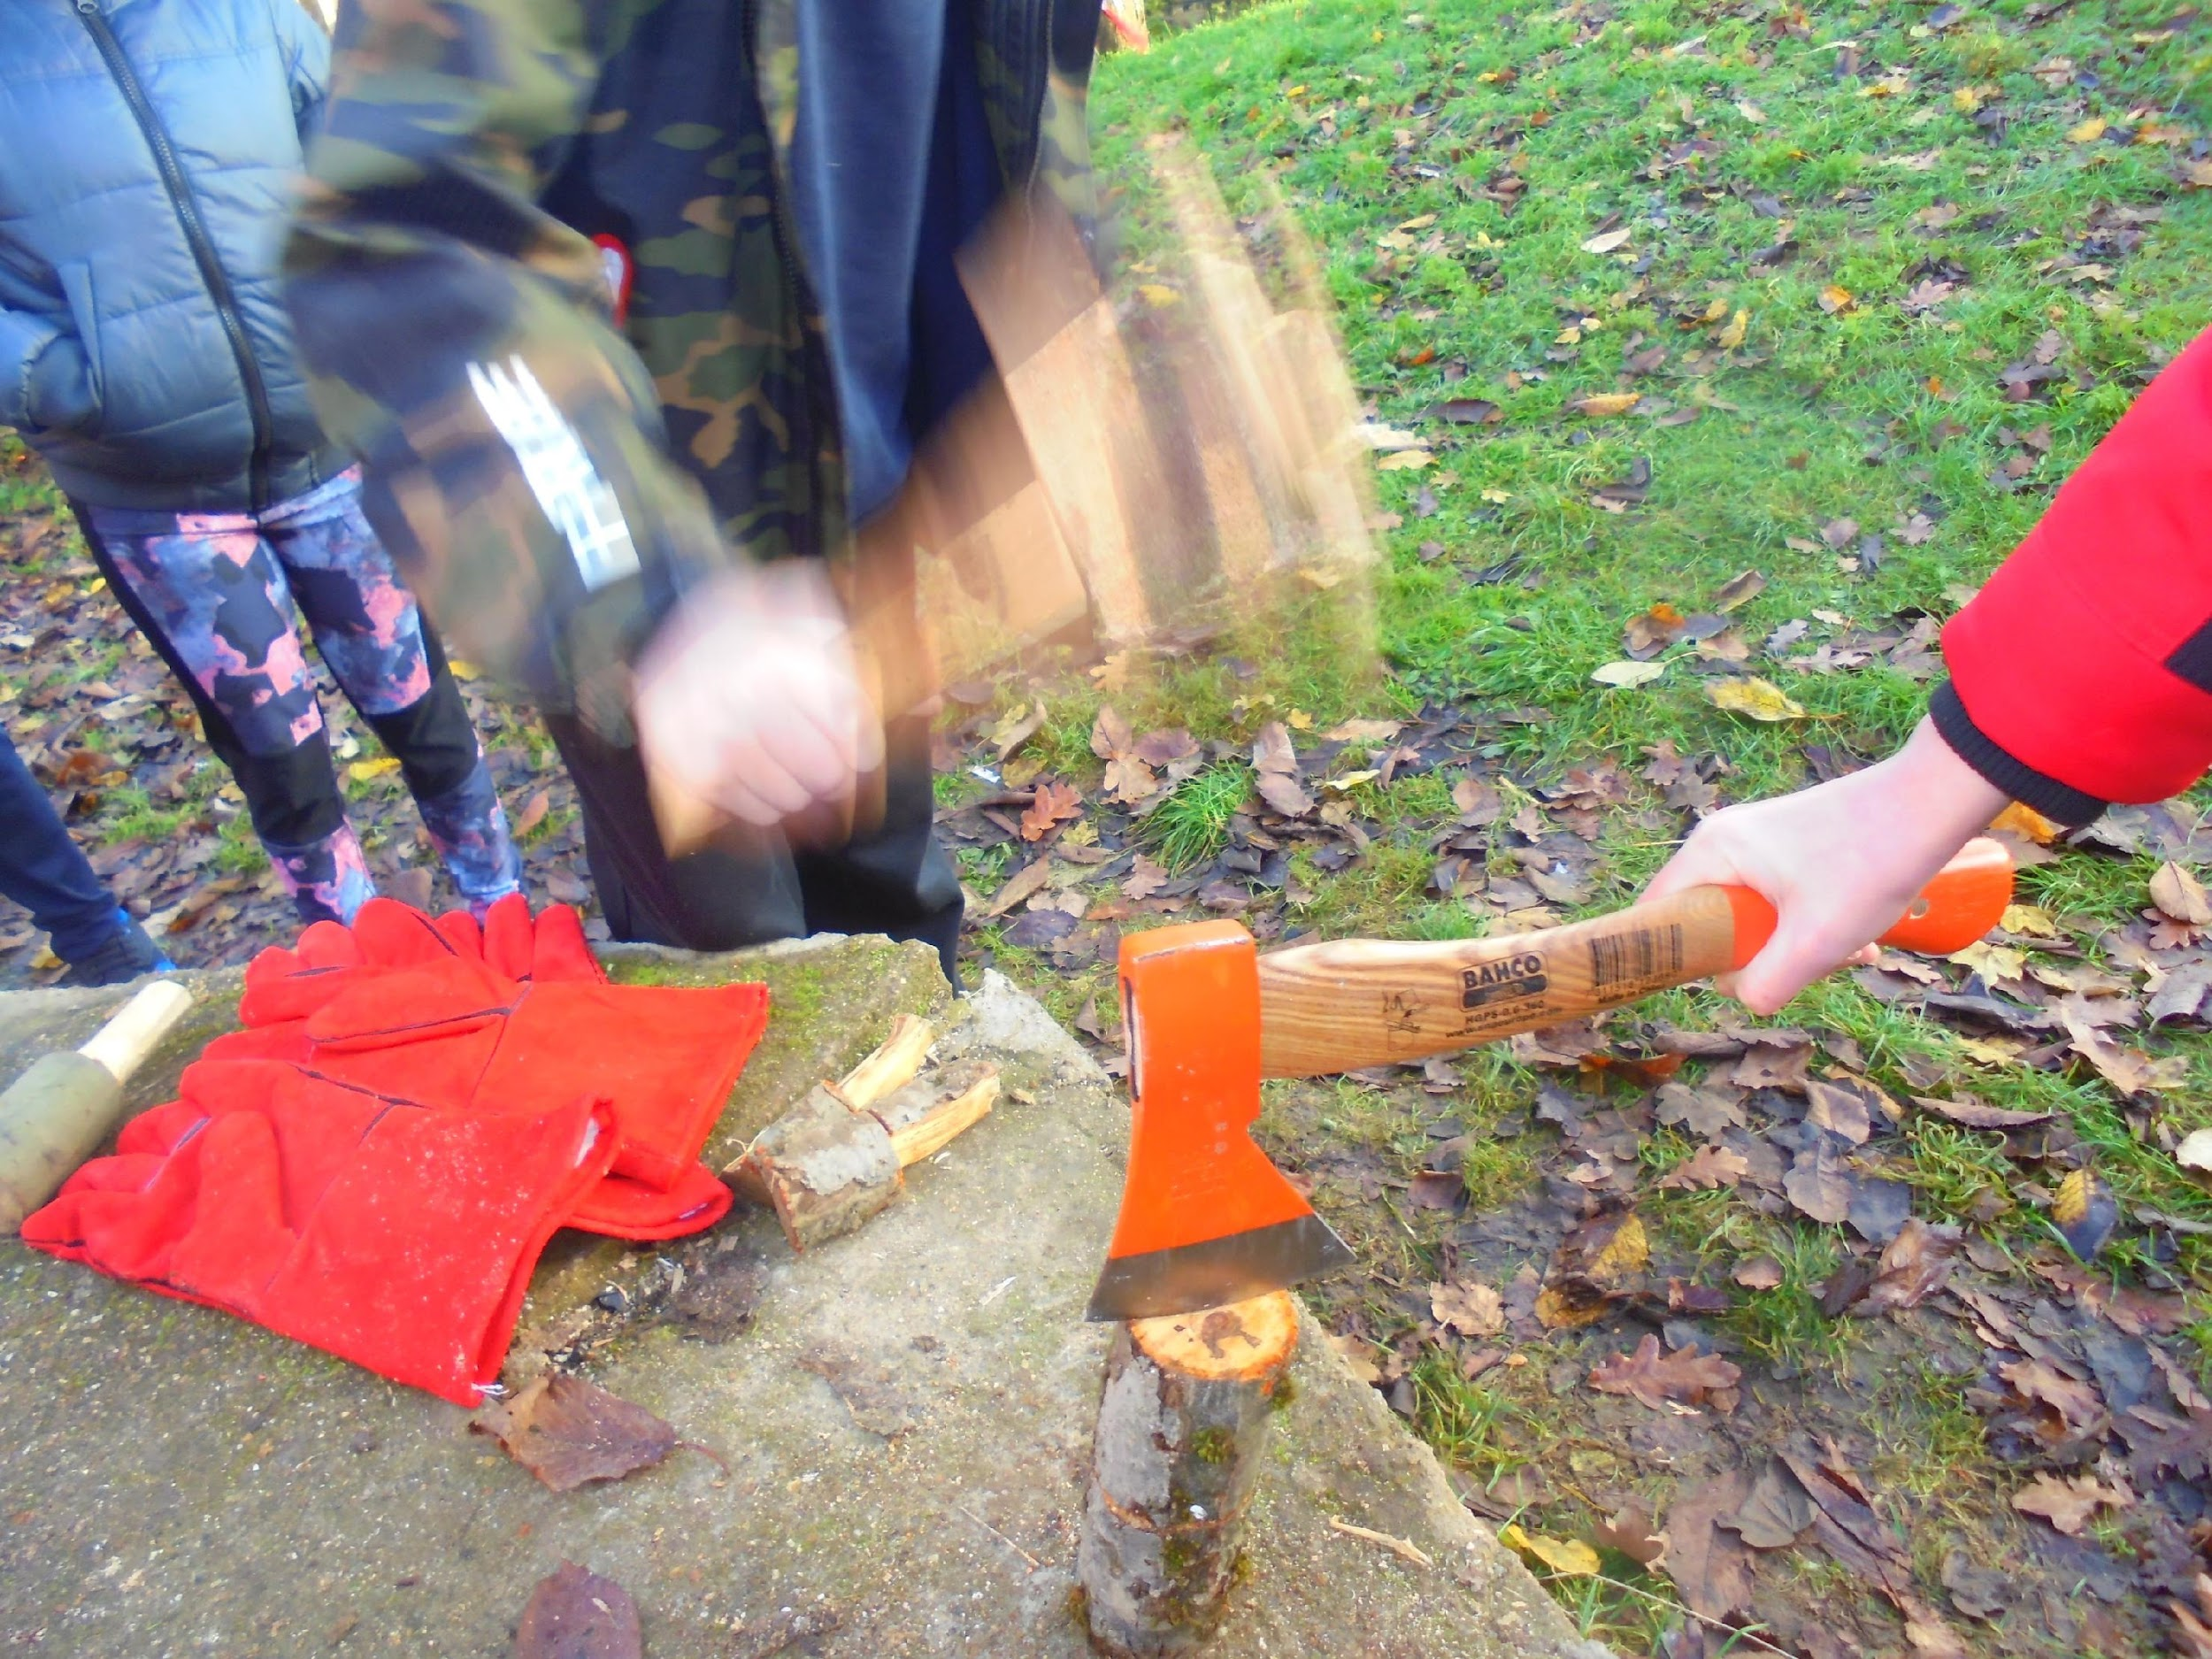

Slide 10
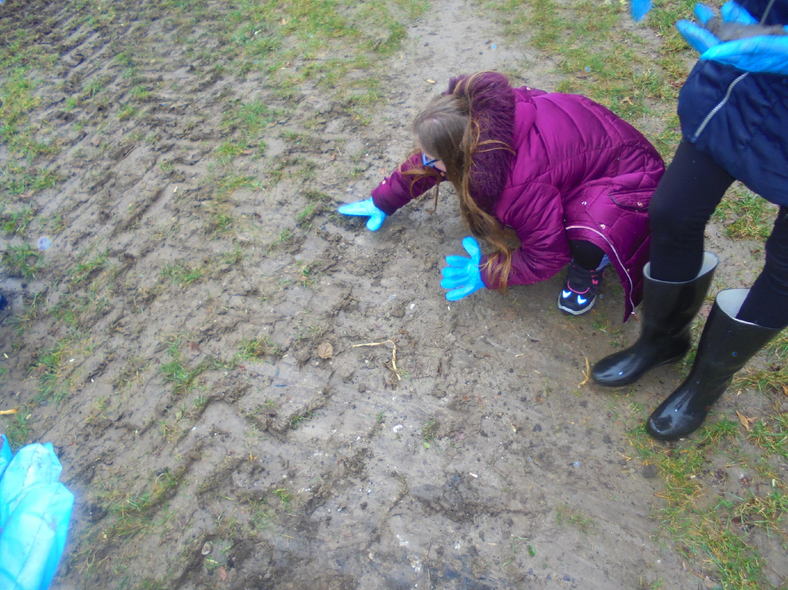
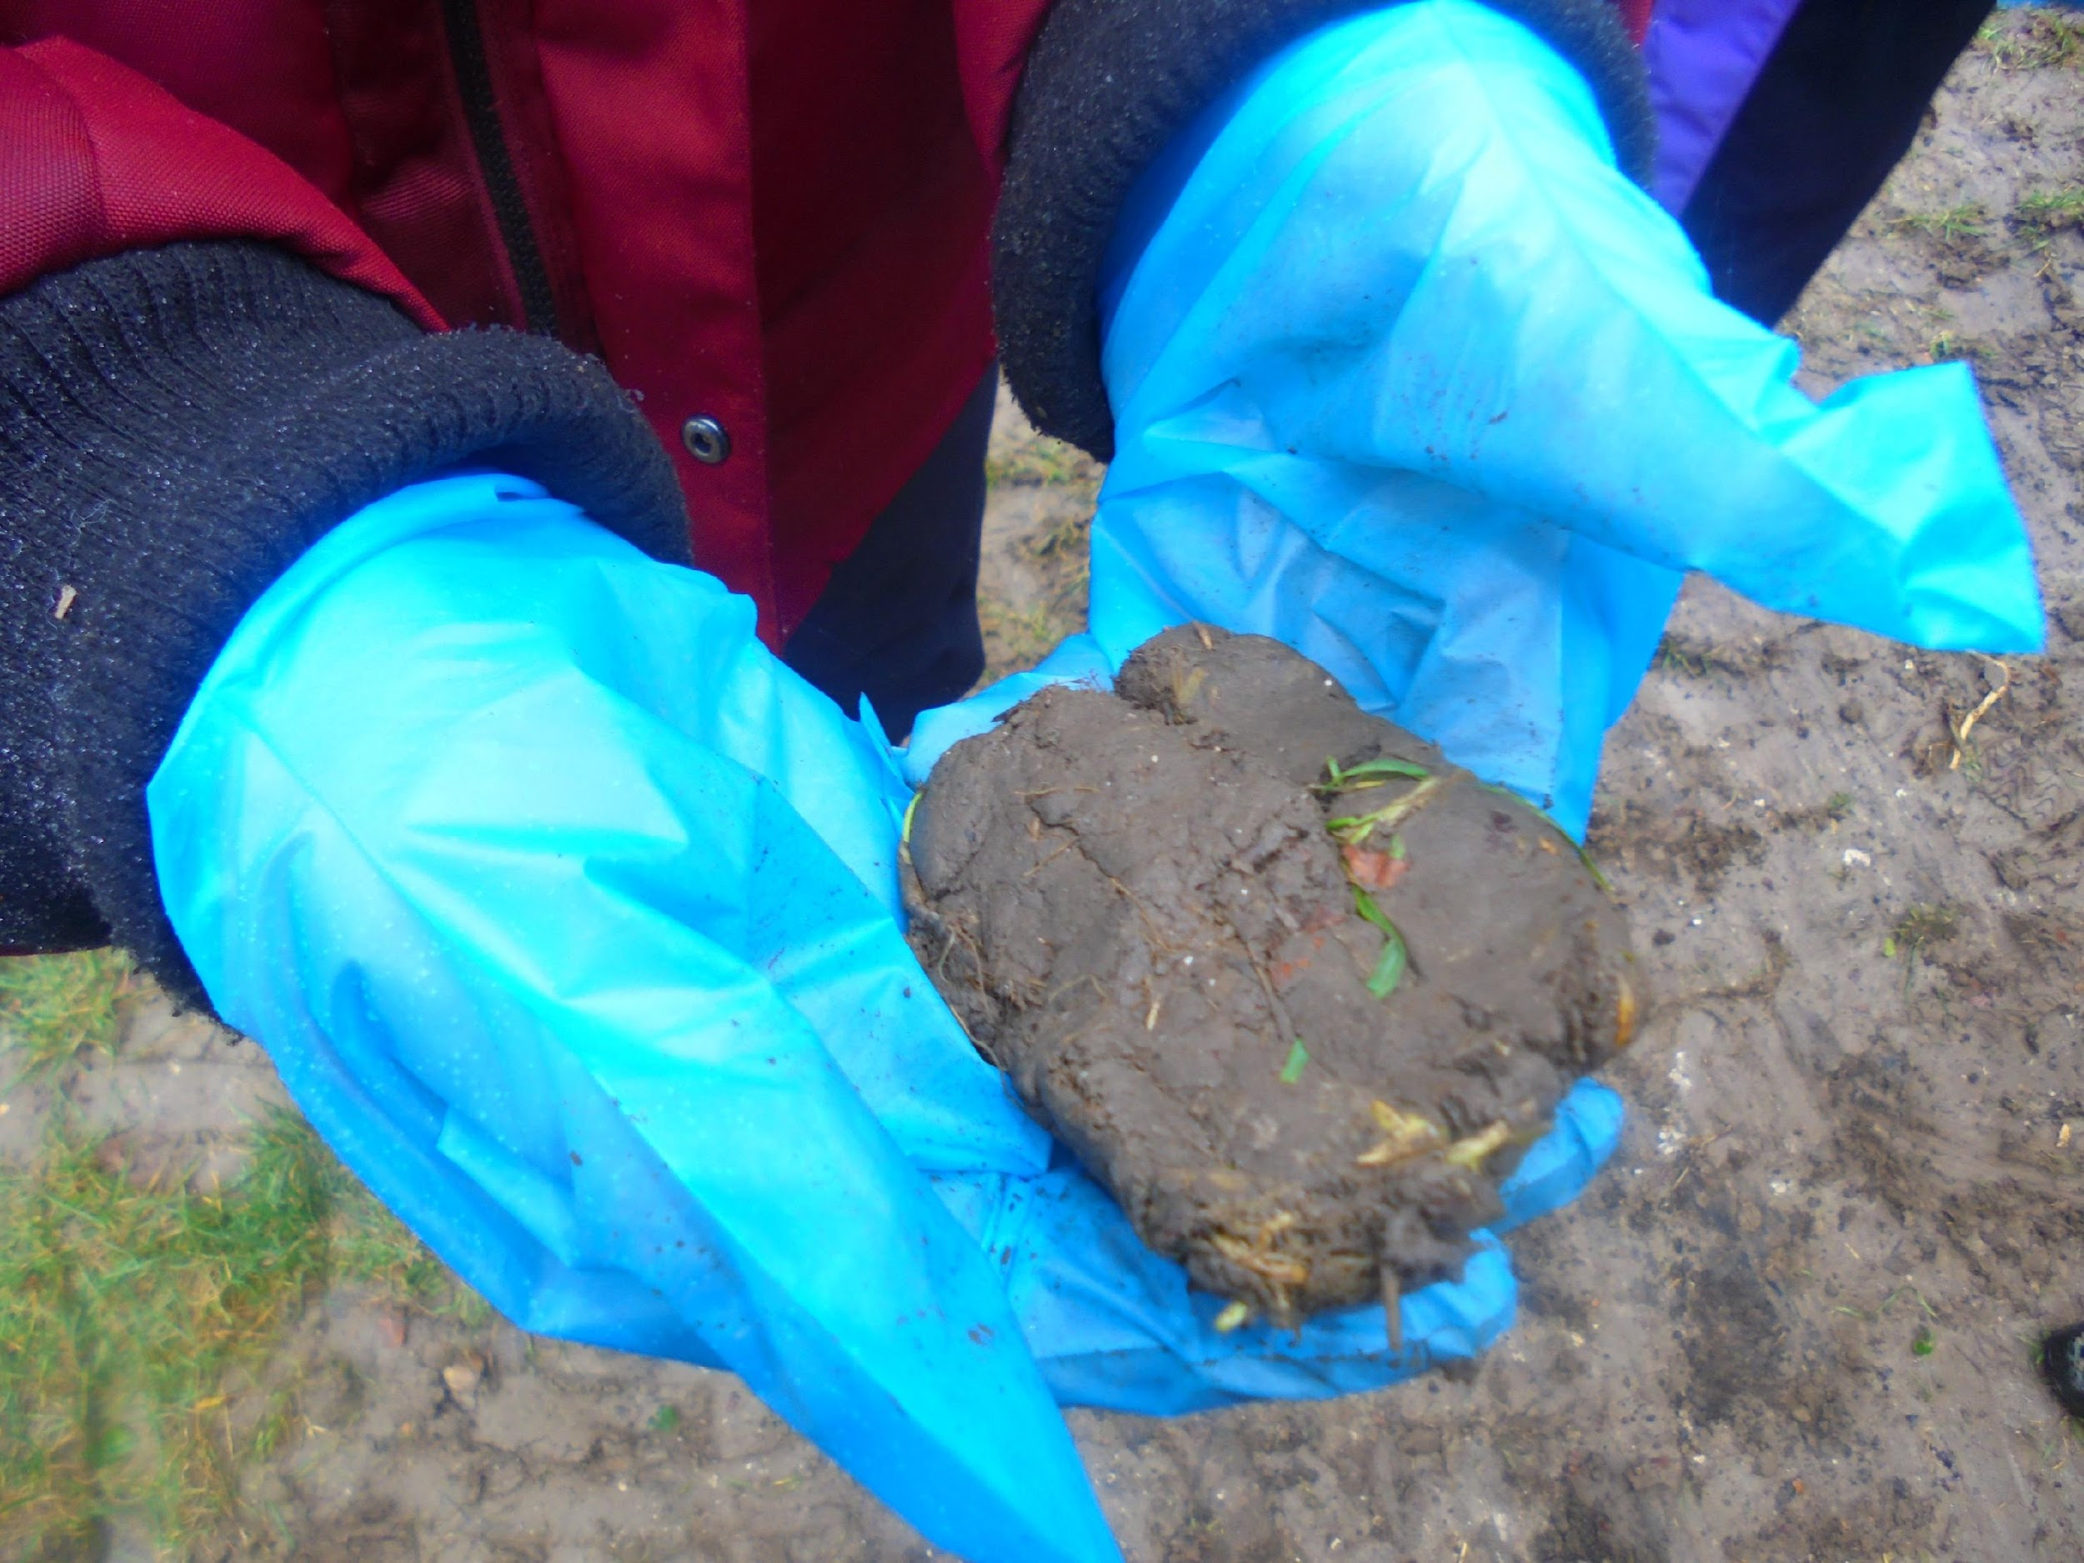
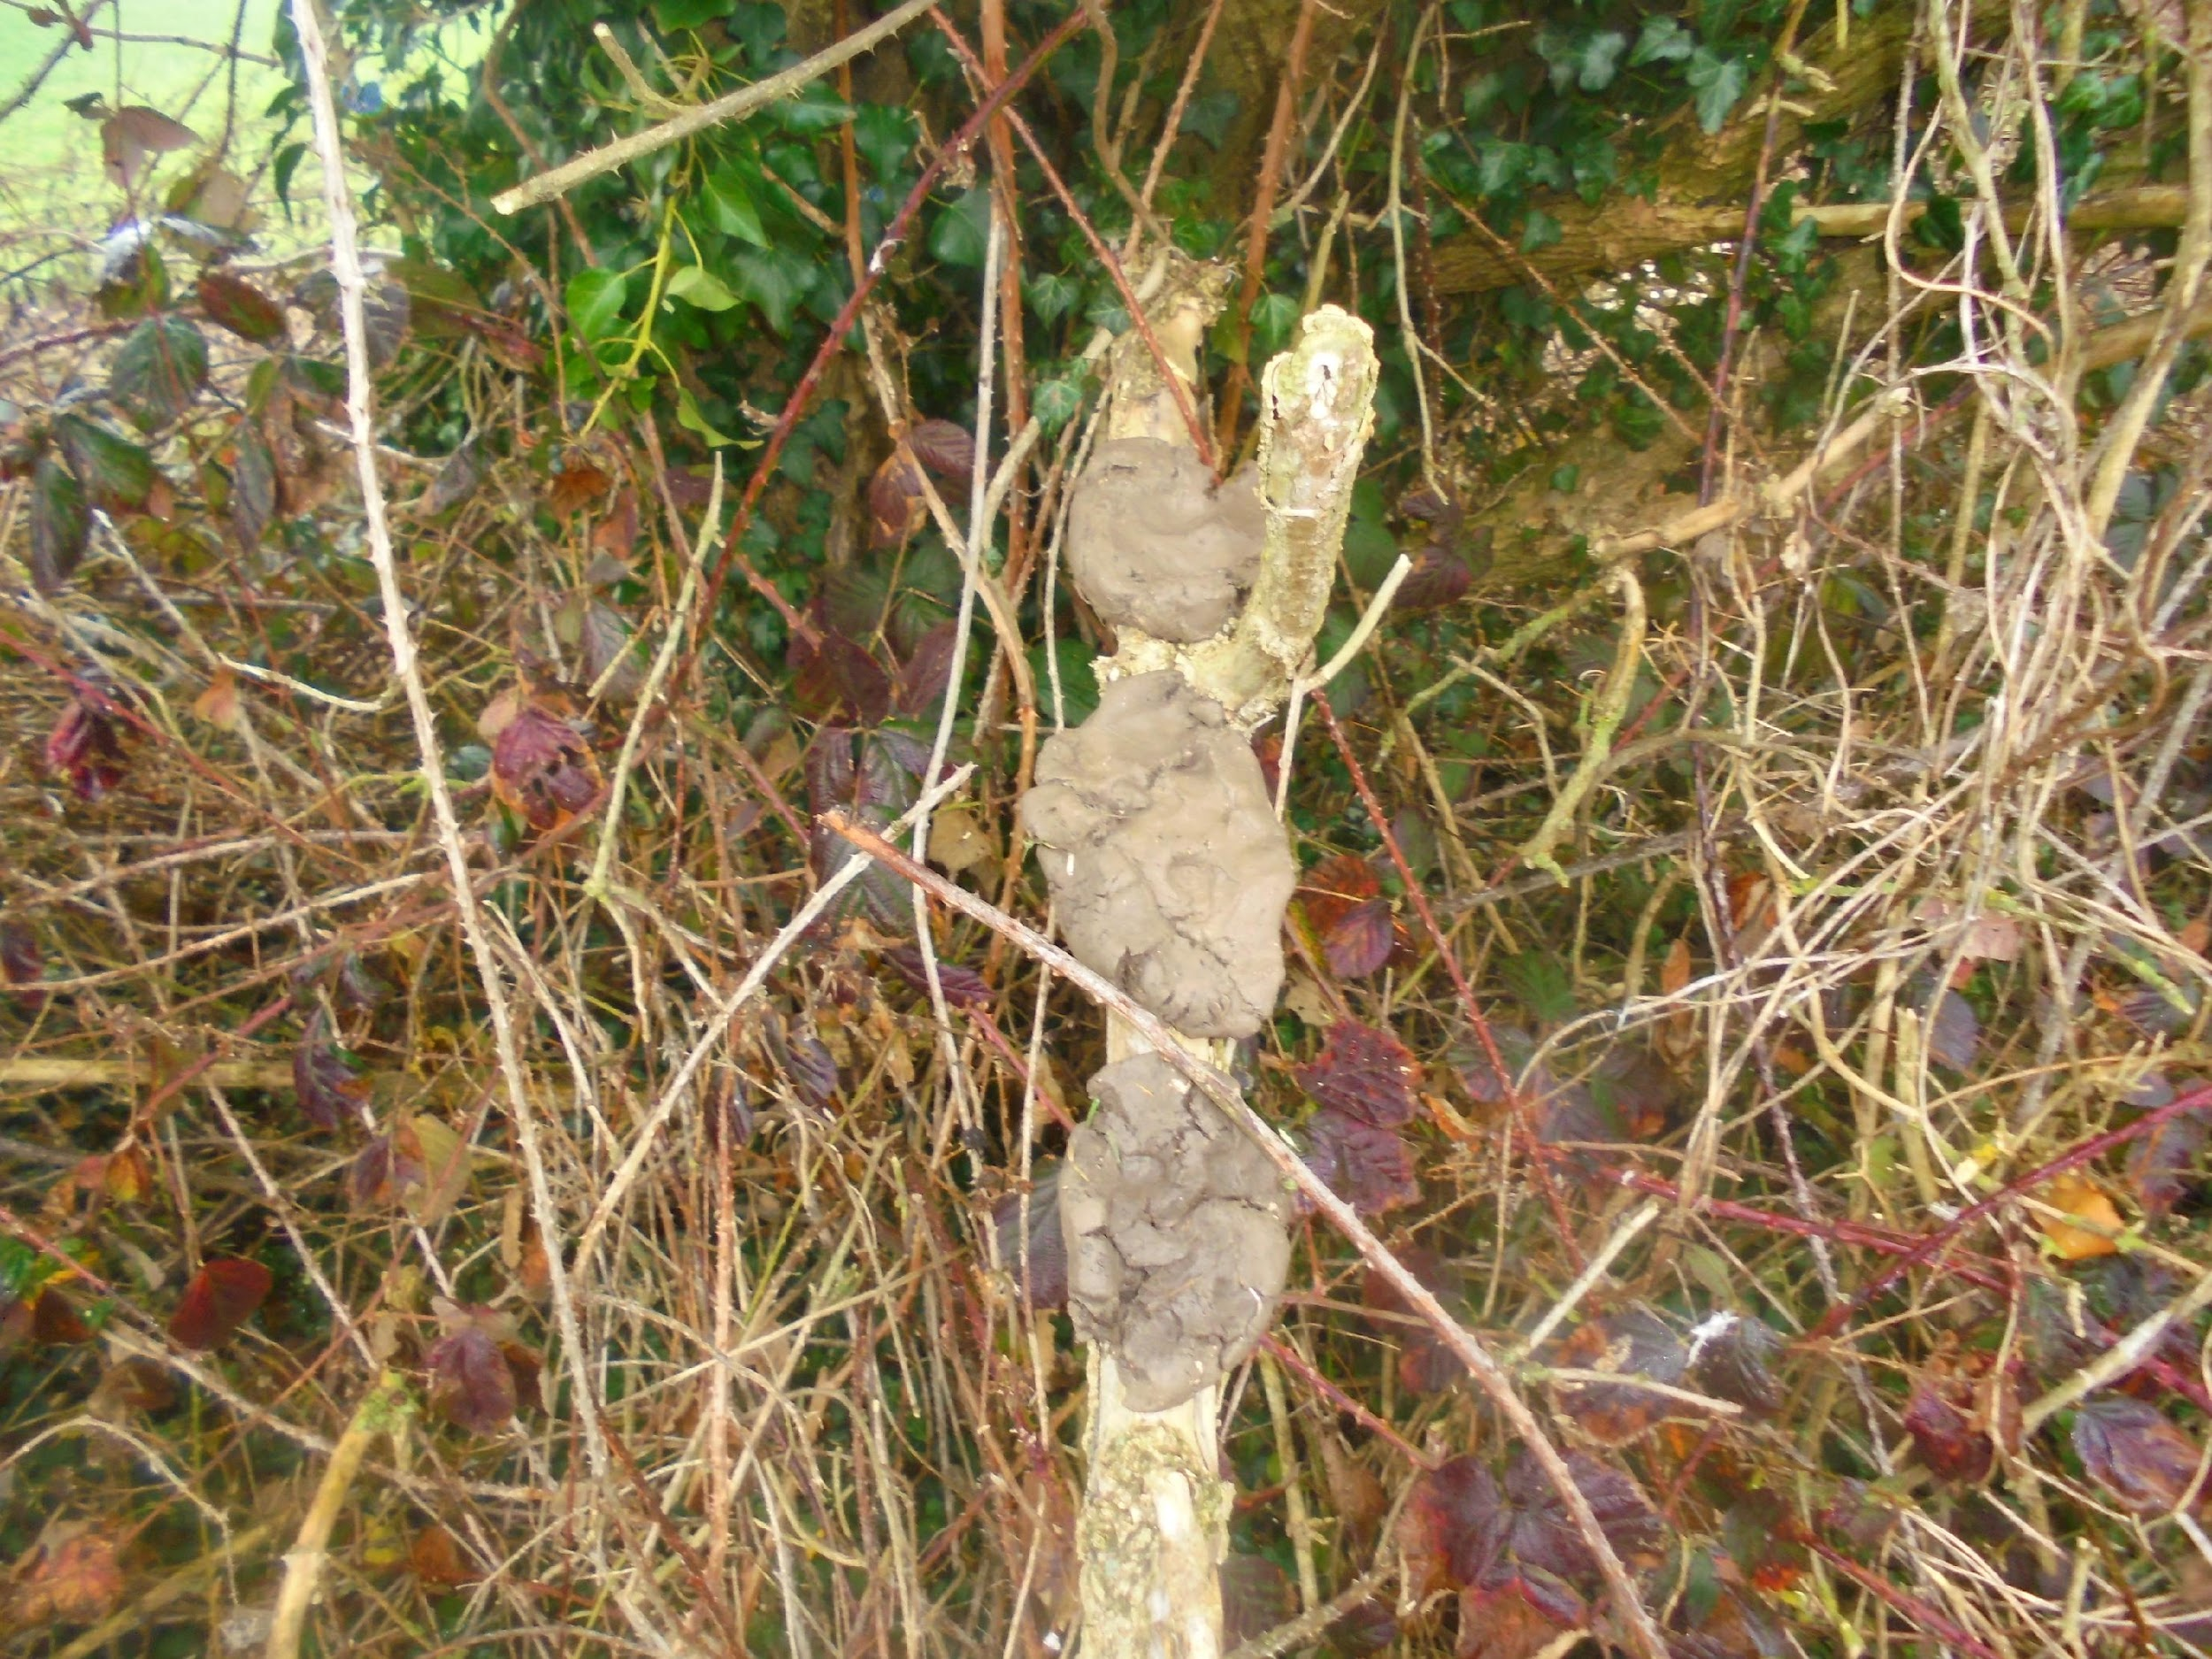

Slide 11
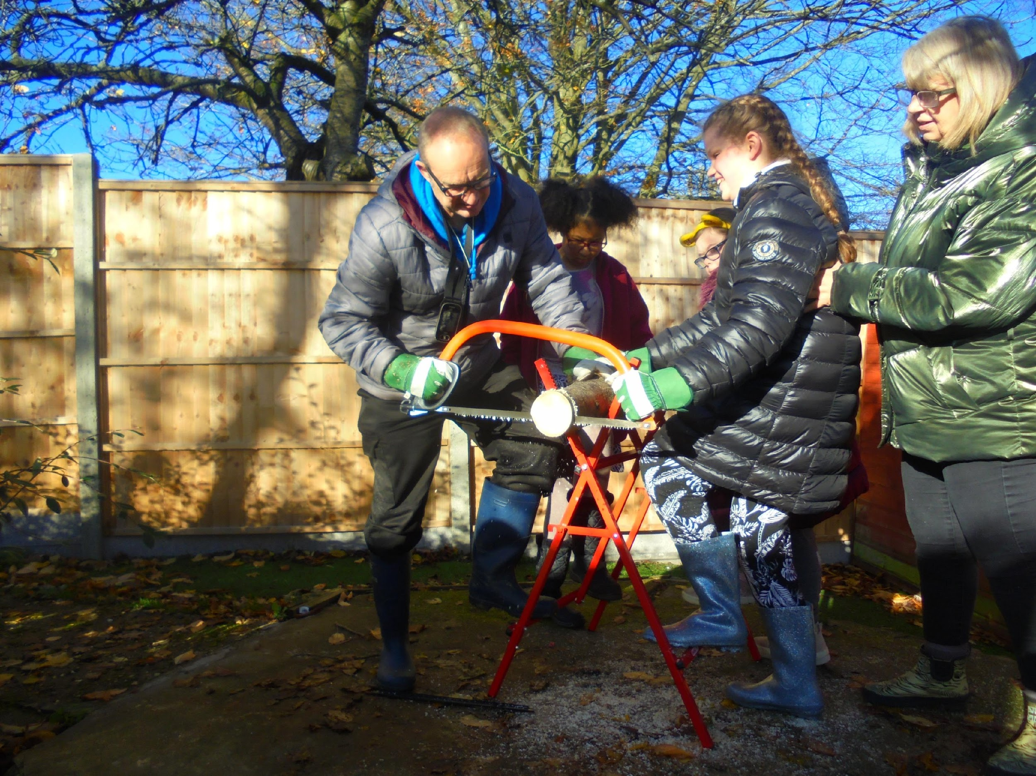
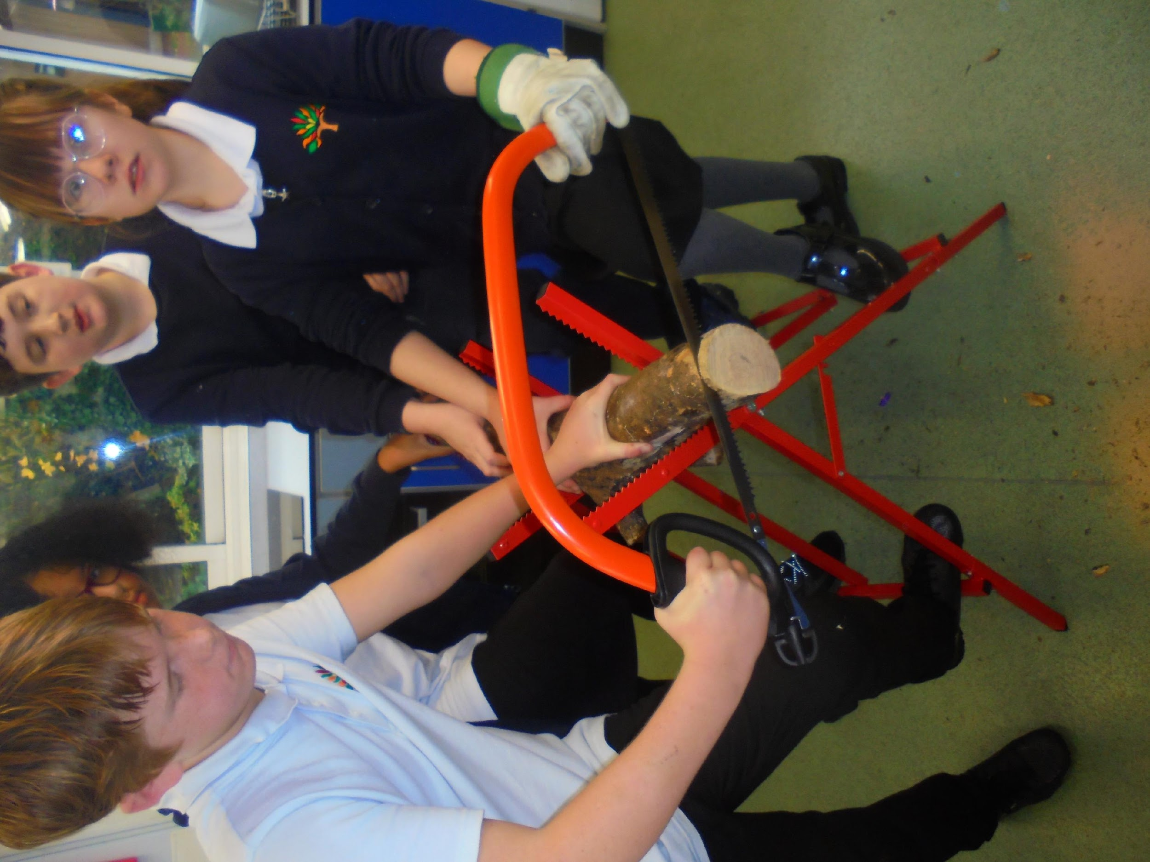

Slide 12
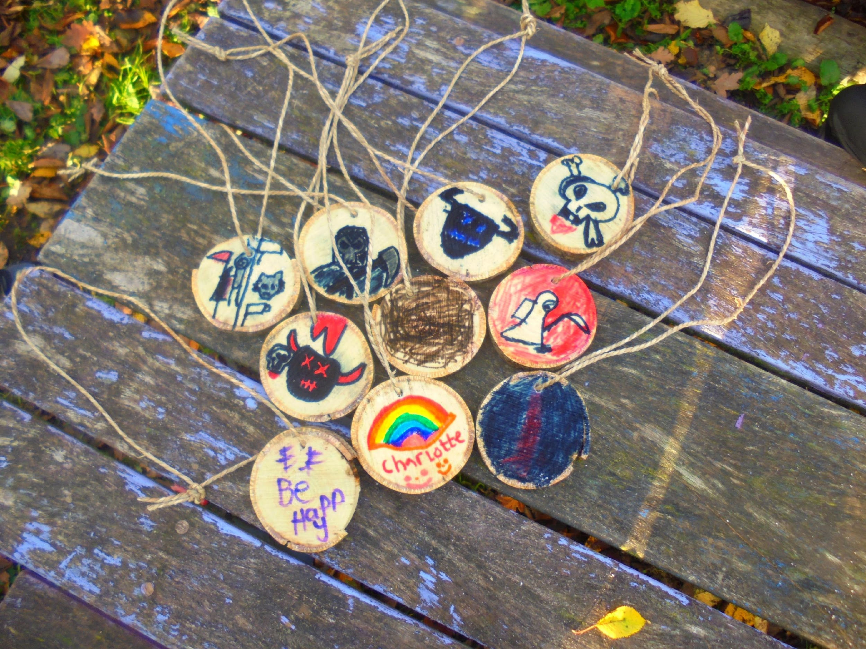
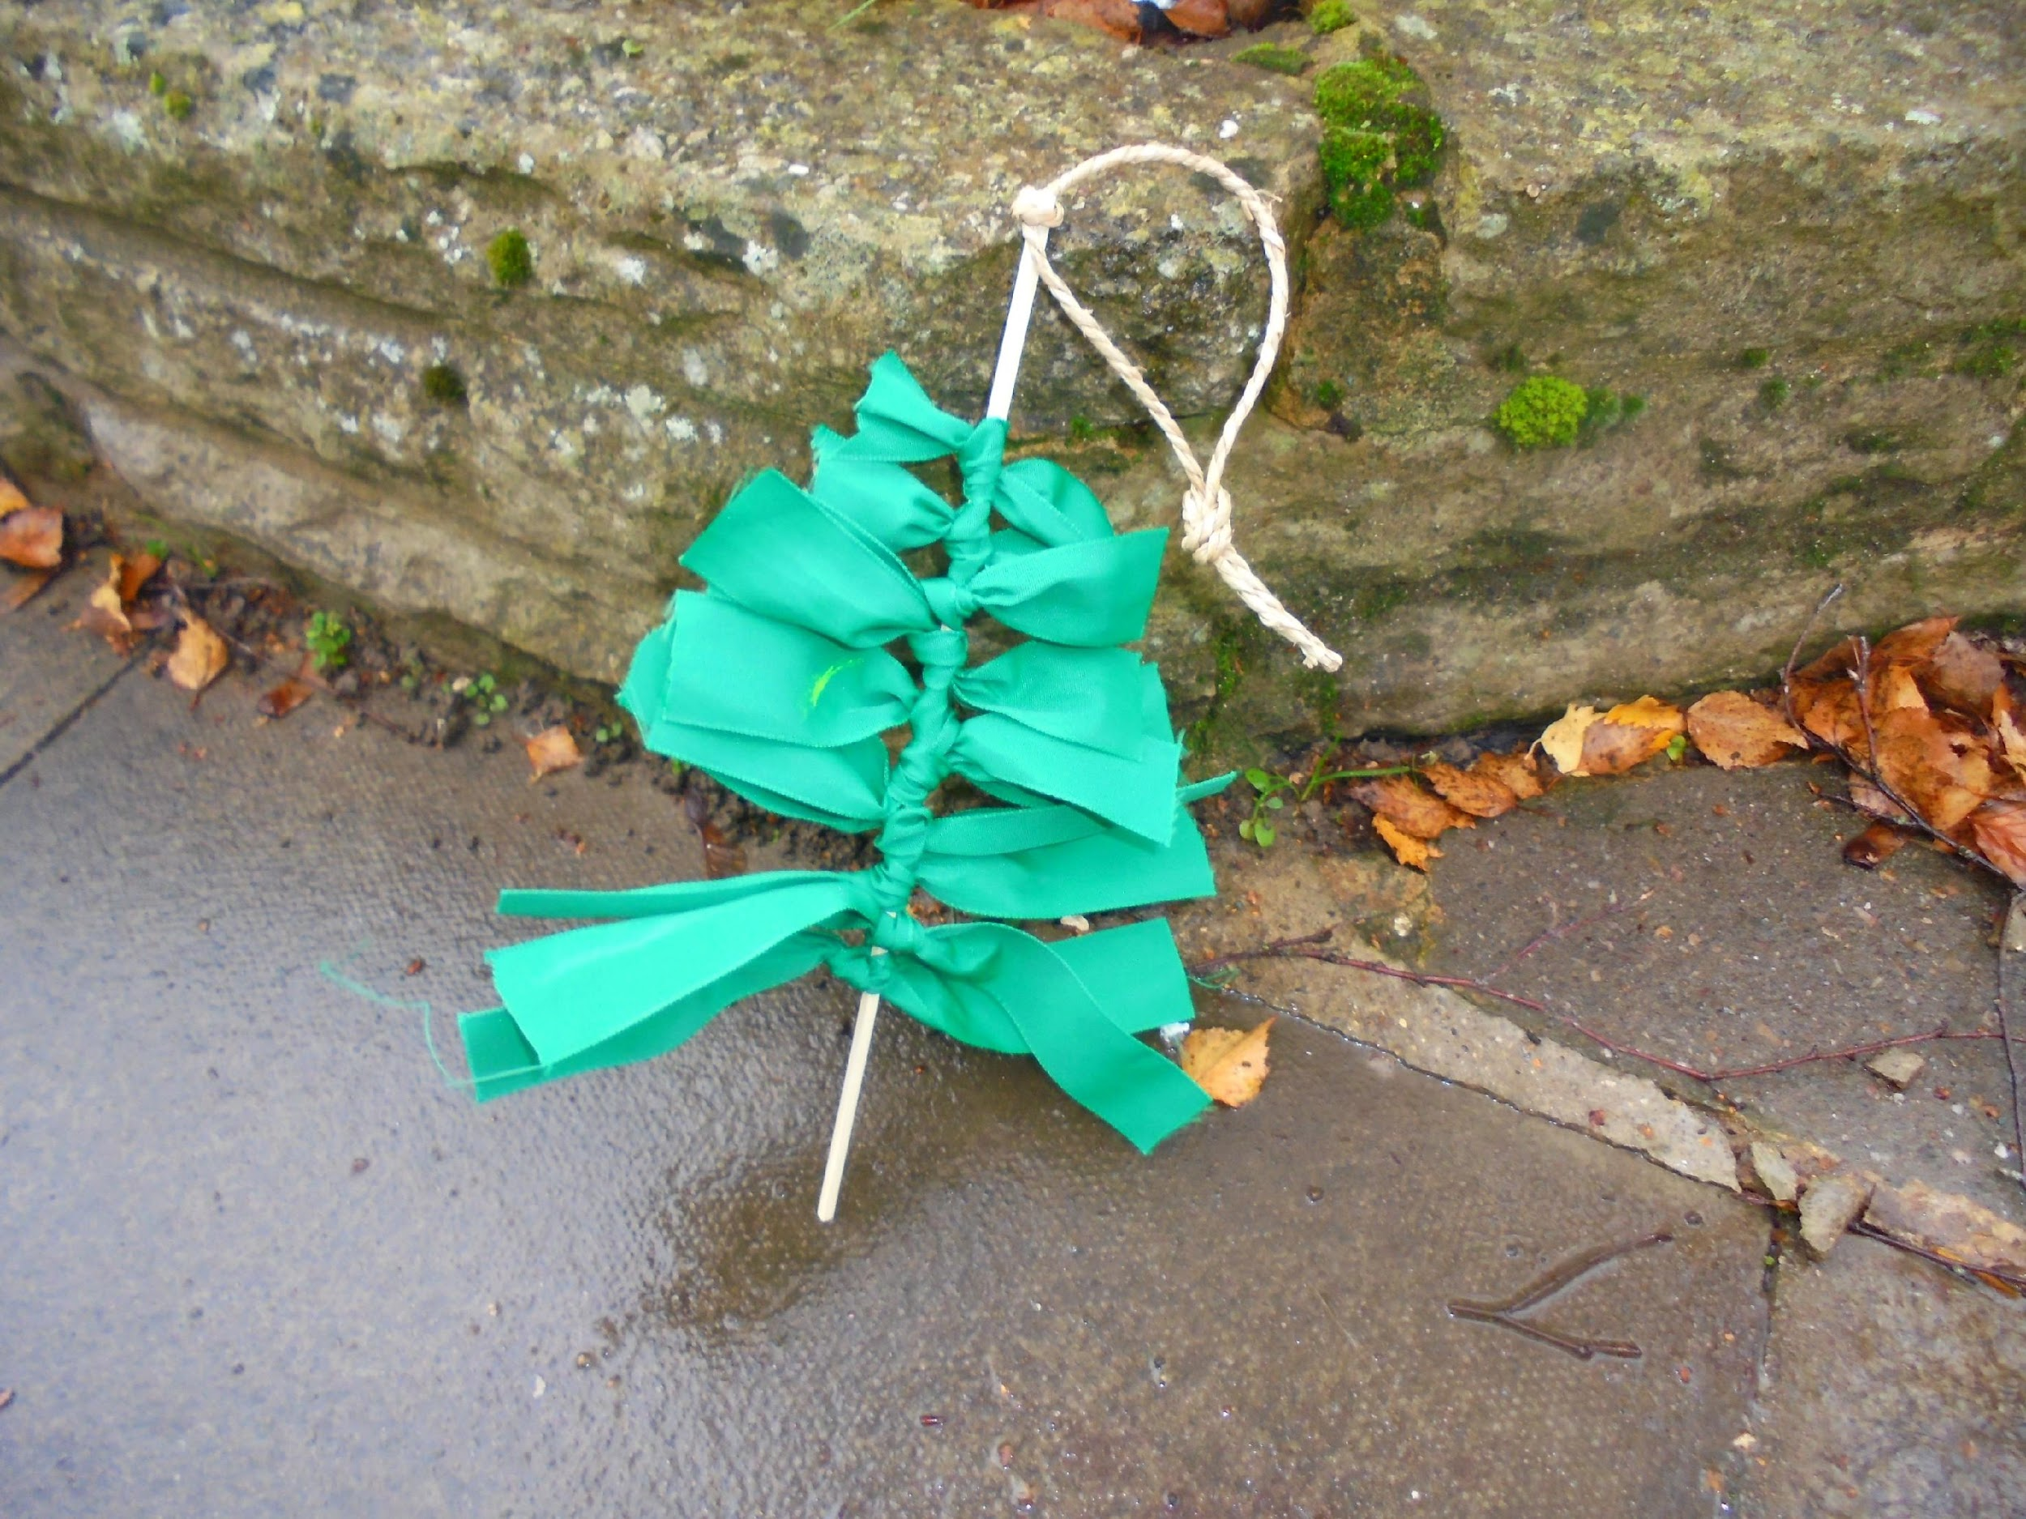
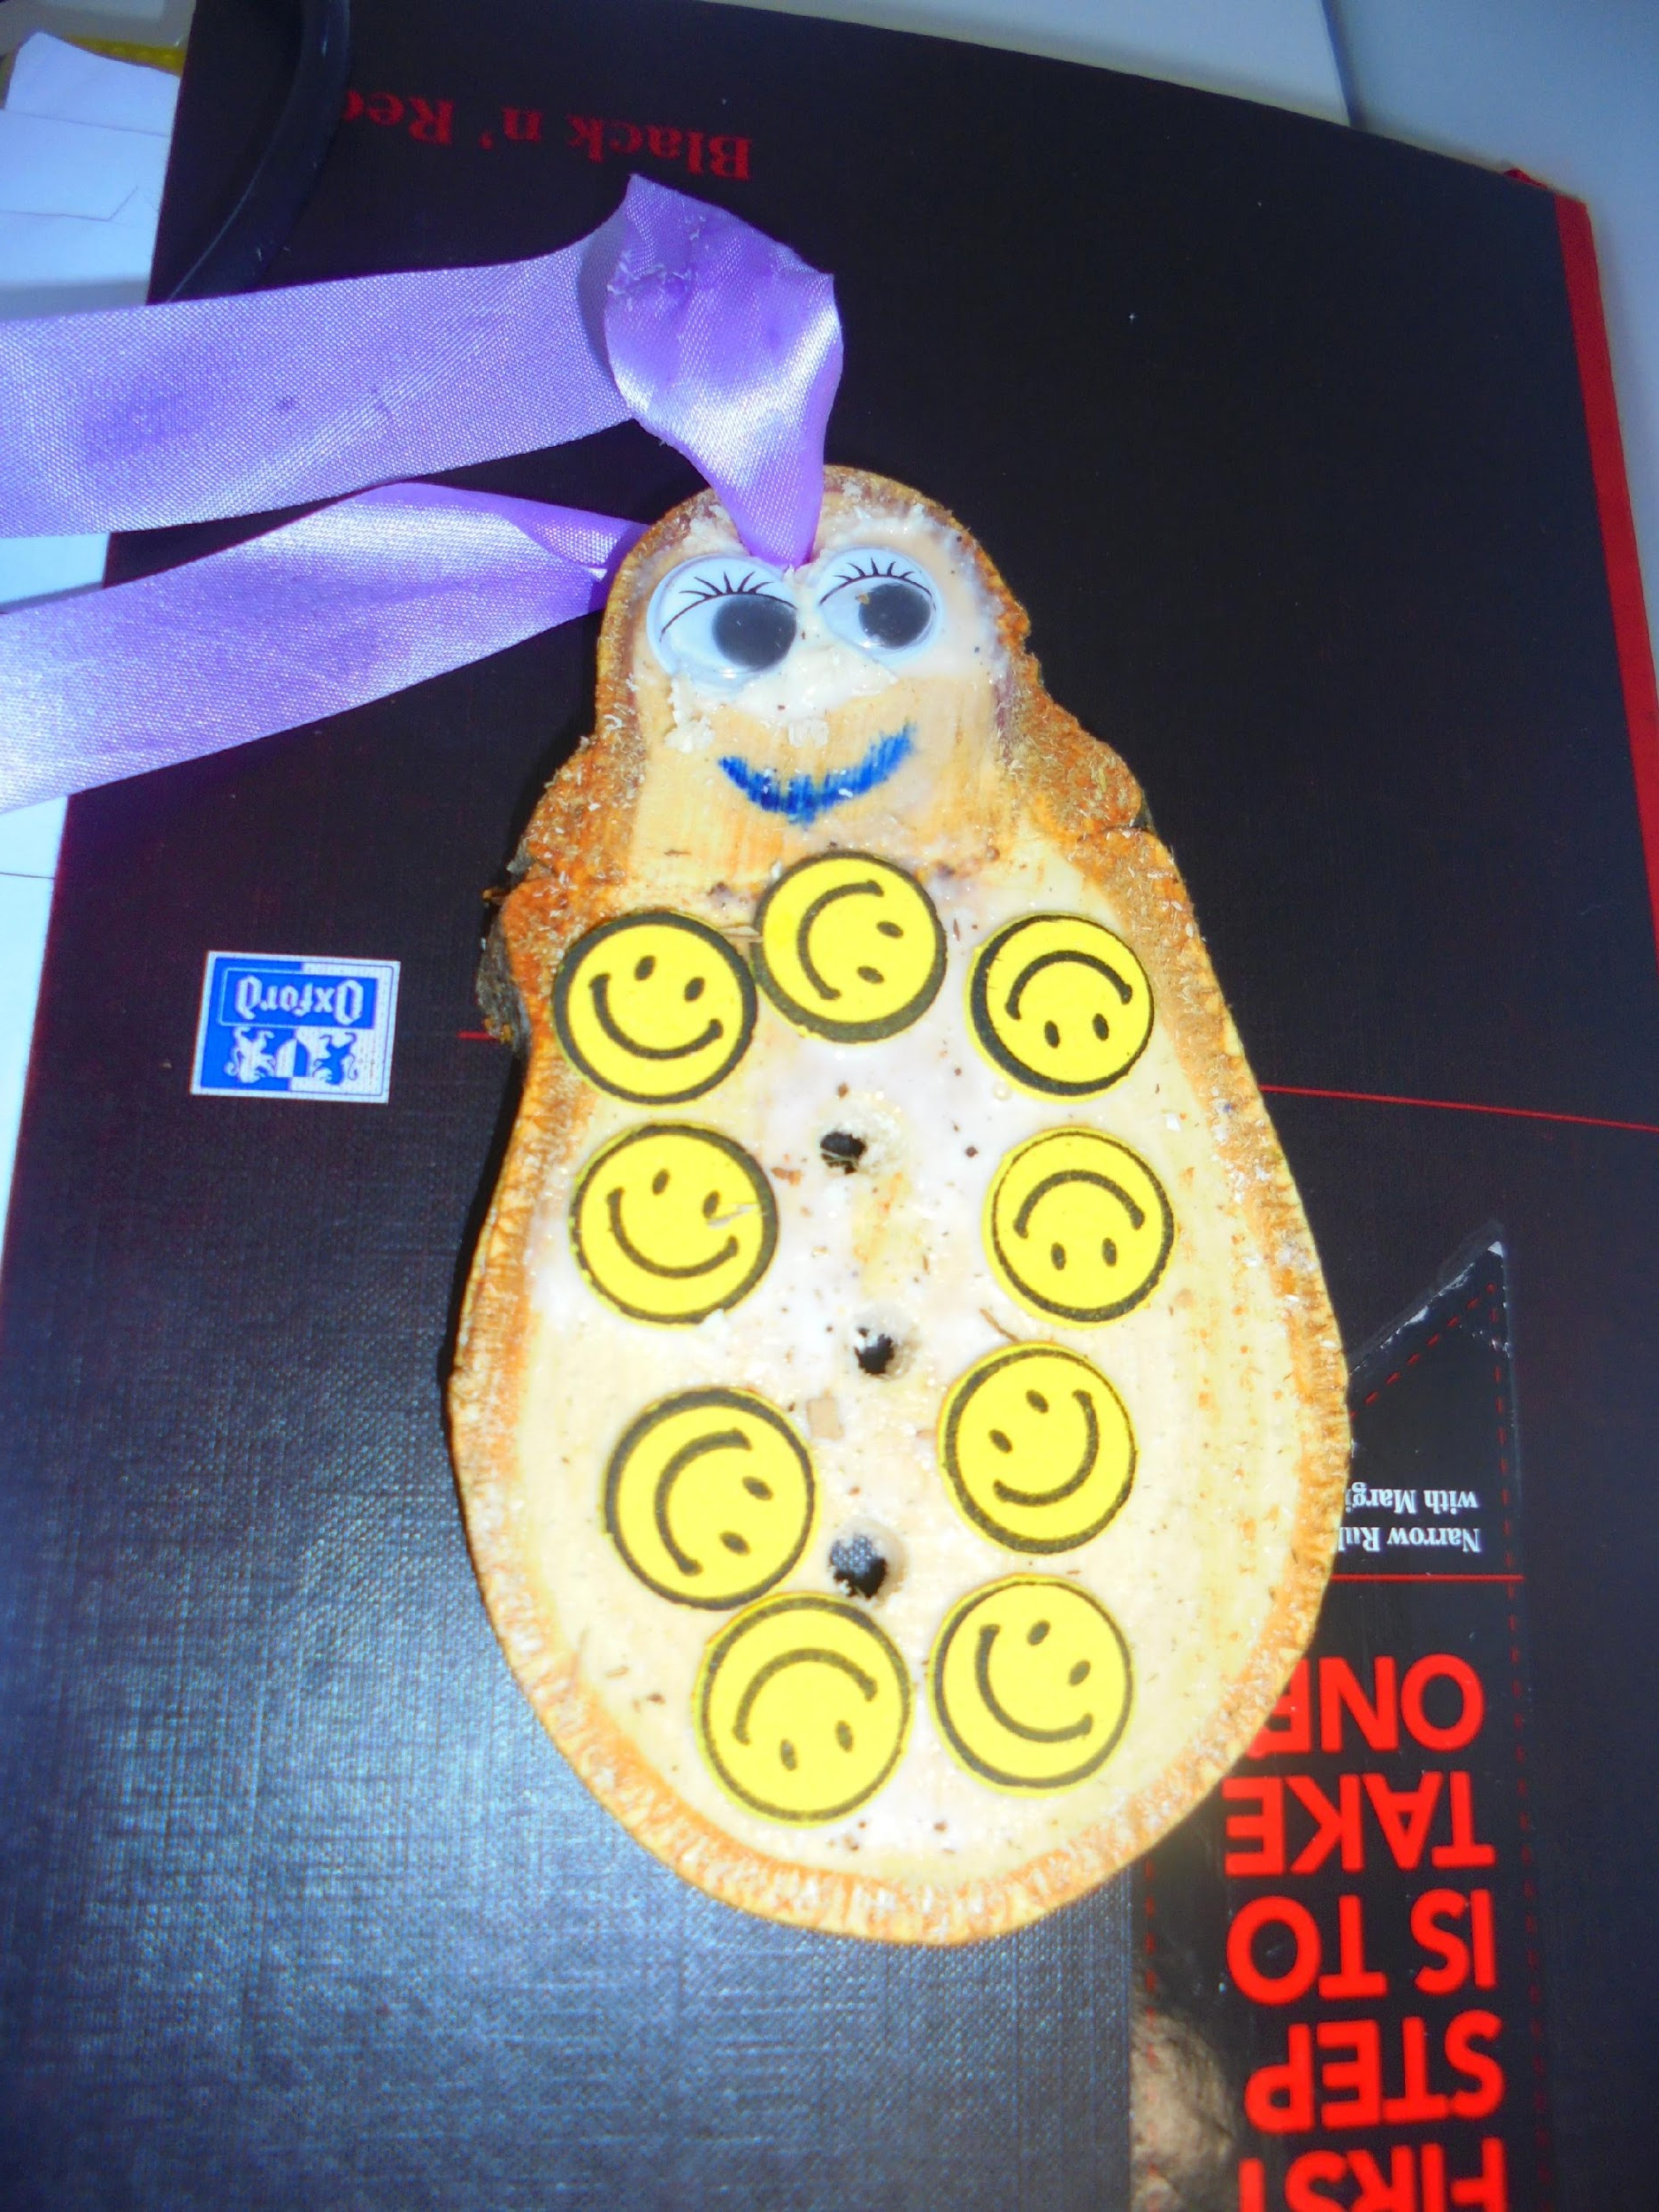
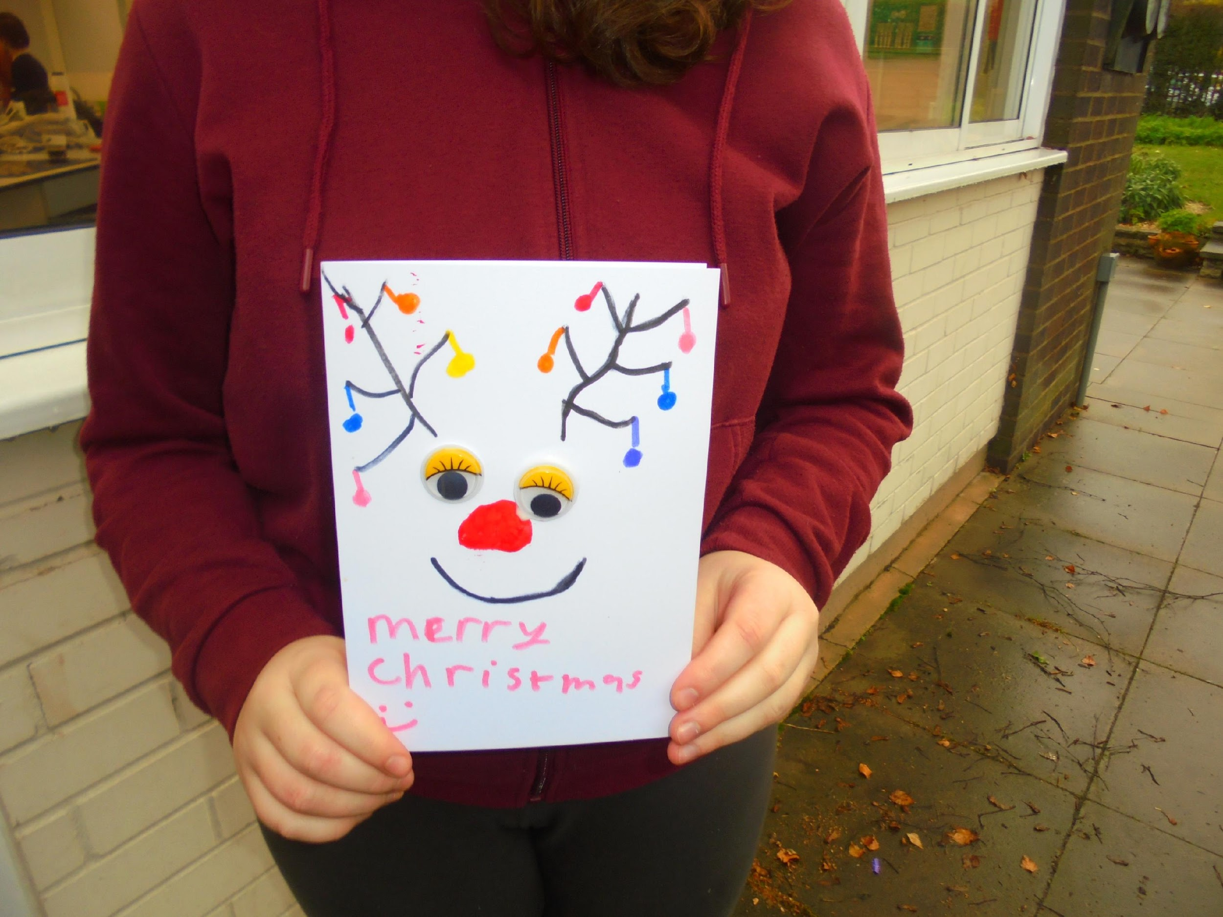

Slide 13
What are the benefits to our learners?
The process helps and facilitates more than knowledge-gathering, it helps learners ….
To develop socially, emotionally, spiritually, physically and intellectually.
To Improve their mental health, well being and physical health.
It creates a safe, non-judgemental nurturing environment for learners to try new activities and take risks together.

Slide 14
How does Forest School fit into
Weatherfield Academy?
KS2 – 6 weeks, 2 hour course Spring 2 Thursday mornings.
KS3 – 1 hour per week in the afternoon.
KS4 – it is part of practical learning sessions on Thursday afternoon.

Slide 15
Evidenced of learning…..
Photos/videos - before and after
Learning outcomes
Skills Builder – team building
Case studies

Slide 16
Future plans…..
Longer sessions – all morning/afternoon/all day
Link to other organisations – plant trees with NT/DD
Over-night camps
Develop learning outcomes for O+U for Forest School
Link to Accreditations and life skills/pre skills
More outdoor learning…………..
Paddlesports, Climbing, Archery

